Slide 1
FINAL PROJECt JCDS07 BSD BANK CUSTOMER CHURN PREDICTION
Andra Pranata Utama | JCDS00702201910003

Slide 2
Project description
Churn Prediction is one of the most common cases in business life.
This project's aim is to predict whether the customer left the bank (closed his account) or he continues to be a customer.

Slide 3
Project GOALS
Create localhost web-based apps to classified bank customer will be exit or retain.
Gather Data
Analyze & Clean Data
Split Data
(Train & Test)
Train model with Train Datasets
Apply Trained Model to Test Datasets
Evaluate Model to Find The Best Model
Deploy Best Model to Apps
Create Apps

Slide 4
DATA INSIGHT
Source : Churn Modelling (Kaggle)
Total Data : 10,000 rows
Columns : 13 Features
(RowNumber, CustomerId, Surname, CreditScore, Geography, Gender, Age, Tenure, Balance, NumOfProducts, HasCrCard, IsActiveMember, EstimatedSalary),
and 1 Feature Target (Exited)

Slide 5
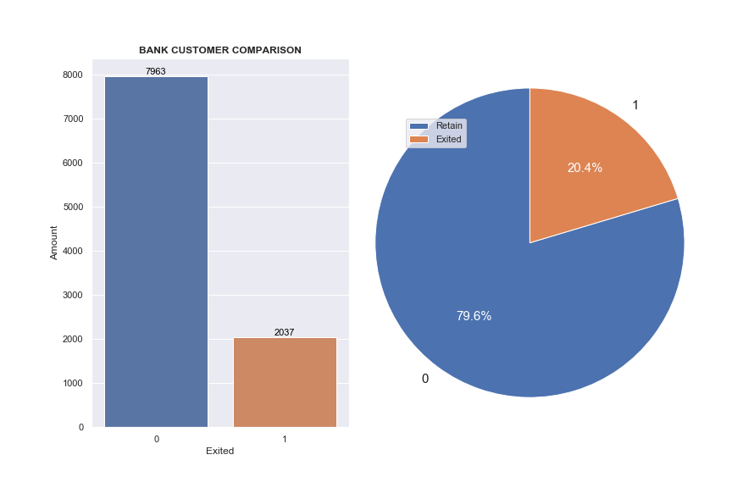
DATA INSIGHT
The data target is not balance, and bias to the Retain Member

Slide 6
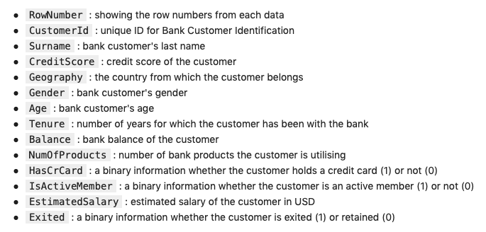
DATA INSIGHT

Slide 7
DATA INSIGHT
There are several assumption from the datasets :
RowNumber, CustomerId, and Surname would be dropped.
Geography and Gender need to be dummied.

Slide 8
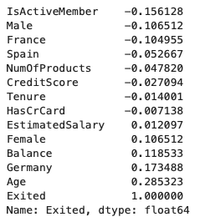
DATA INSIGHT
The Correlation plot :
Age (28.5%)
German (17.3%)
Active (-15.6%)
Balance (11.8%)
Gender (10.6%)

Slide 9
DATA INSIGHT
There are several insights from the dataset :
Geography, Gender, Age, Balance, NumOfProducts, and IsActiveMember have correlation to target.
CreditCard, Tenure, and EstimatedSalary almost have no significant correlation to target.

Slide 10
MACHINE LEARNING MODEL
There are 4 models that I choose :
Logistic Regression
Decision Tree Classifier
K-Neighbor Classifier
Random Forest Classifier
Every models gonna be Hypertuned with RandomizedSearchCV

Slide 11
MACHINE LEARNING MODEL
To evaluate each model, I choose : (either the base model, or best model which was hypertuned)
Classification Report
AUC Score
In the end, I compare each model with the Accuracy Score.

Slide 12
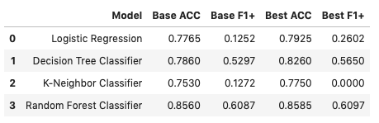
MACHINE LEARNING MODEL
From the comparation between Accuracy Score, I choose the hypertuned Random Forest Classifier as my final Machine Learning model.

Slide 13
MACHINE LEARNING MODEL
From the choosen model, here are the Top 5 Important Features :
Age (26.07%)
NumOfProducts (15.84%)
Balance (13.62%)
CreditScore(12.37%)
EstimatedSalary (12%)

Slide 14
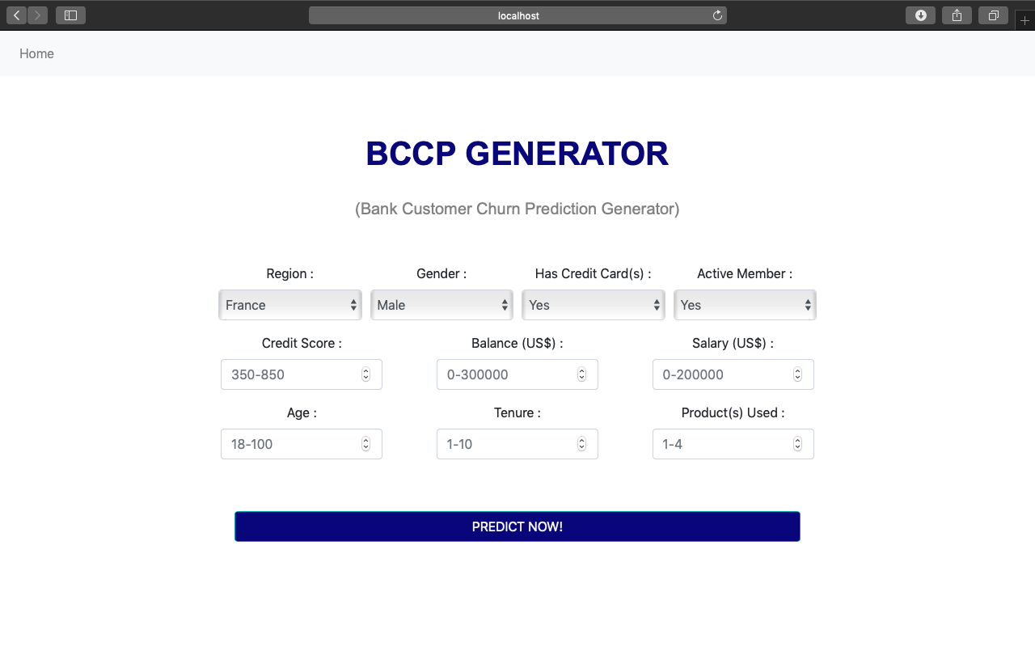
Home PAGE | APPS

Slide 15
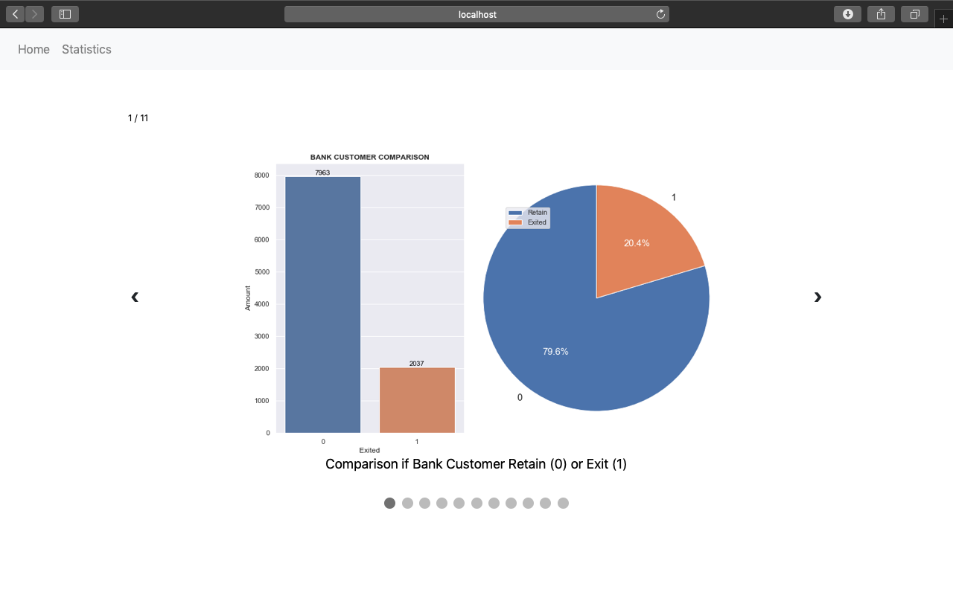
STATISTIC PAGE | APPS

Slide 16
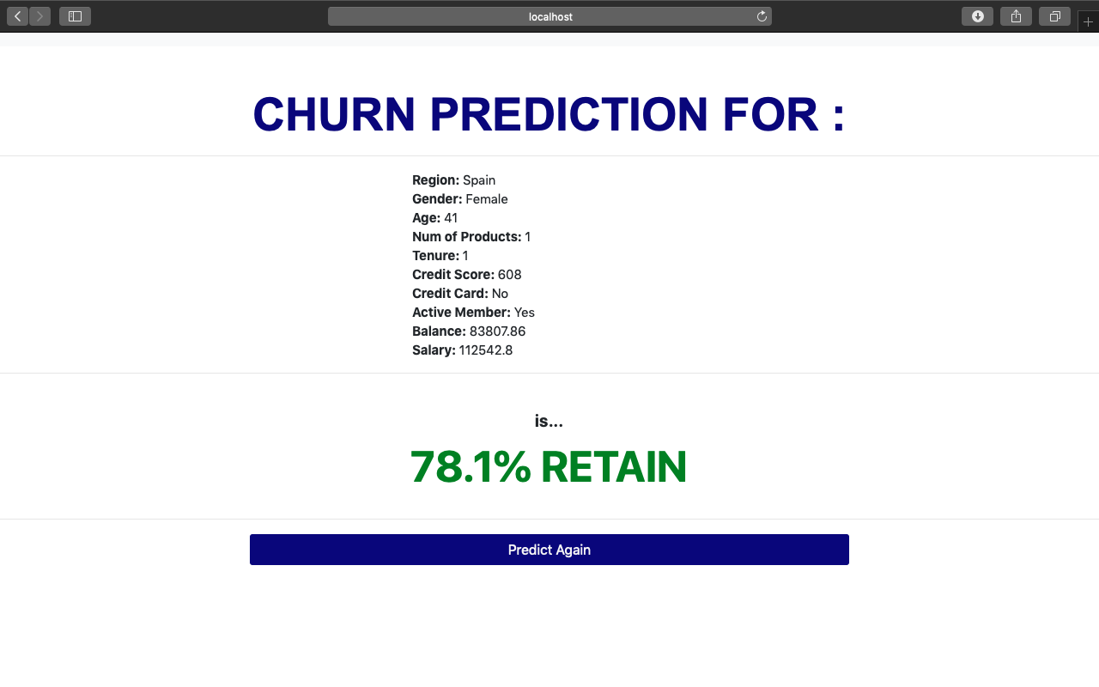
RESULT PAGE | APPS
If the prediction customer would be retain.

Slide 17
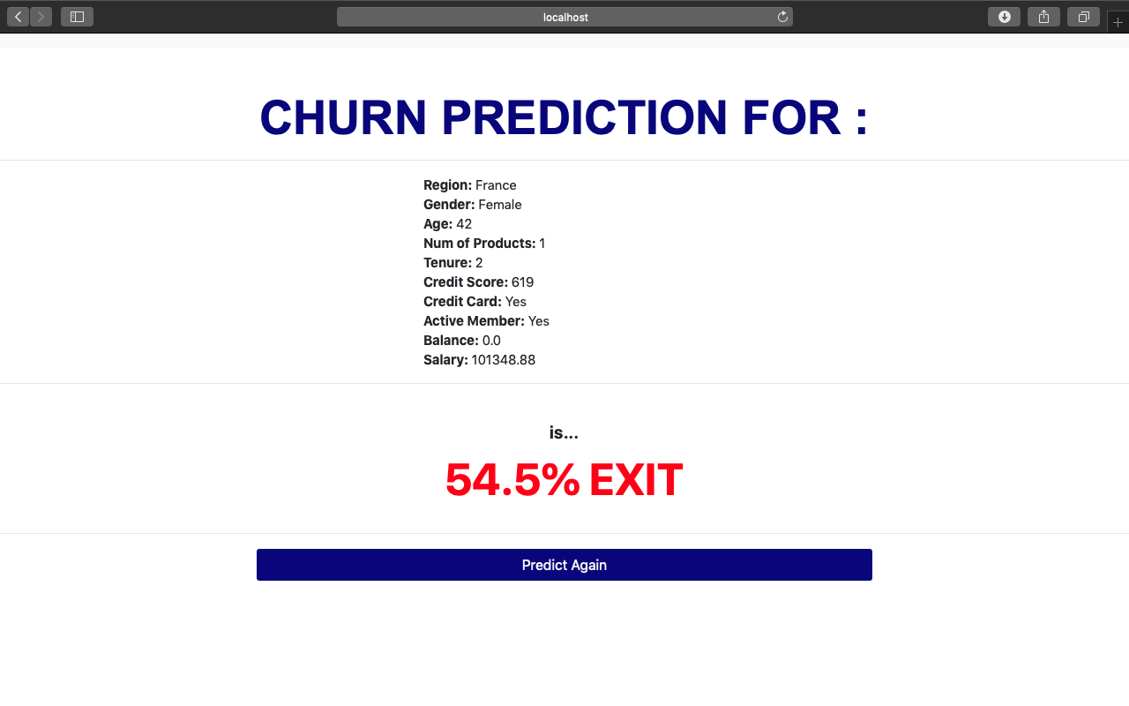
RESULT PAGE | APPS
If the prediction customer would be exit.

